Slide 1
Network Security Project
CONFIGURING A FIREWALL ON THE SERVER
BY: Y@h@ck5 +2348140879281

Slide 2
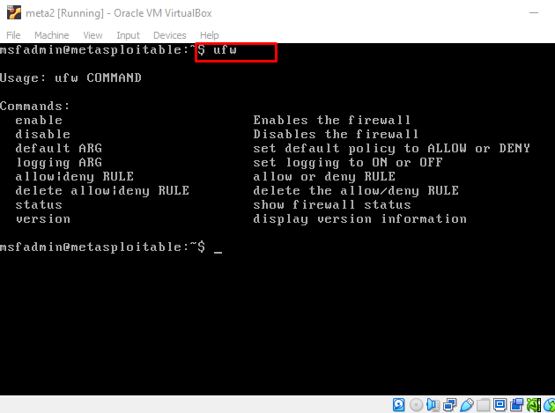
Uncomplicated Firewall
To configure a firewall on the Server(Metasploitable2) machine, Install the UFW(Uncomplicated Firewall) with the command:apt-get install ufw
Once installed type ufw to see the command usage.

Slide 3
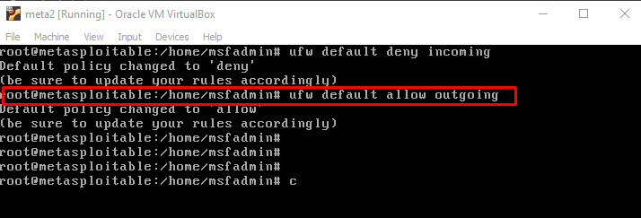
Configure UFW
To block incoming connections use the command: ufw default deny incoming
To allow outgoing connections use the command: ufw default allow outgoing

Slide 4
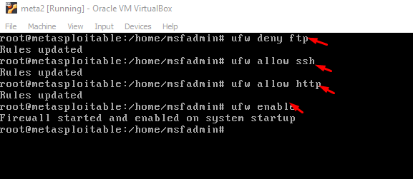
Disabling Vulnerable Ports
To disable the highly vulnerable ports, use the command: ufw deny ftp
To allow a port use the command: ufw allow ssh as seen in the image.
After set up remember to enable the firewall using: ufw enable

Slide 5
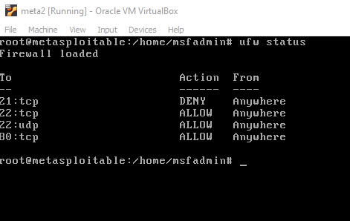
Confirm Configuration
Type ufw status command to confirm that the previous configuration are in place.

Slide 6
THANKS
NEXT:MORNITOR NETWORK TRAFFIC

